Slide 1

SMART INDIA HACKATHON 2026
TITLE PAGE
Problem Statement ID – SIH26076
Personalised homepage for the Mausam mobile application
Theme – Smart Automation
PS Category – Software
Team ID – [as registered on the portal]
Team Name – [to be filled before upload]

Slide 2
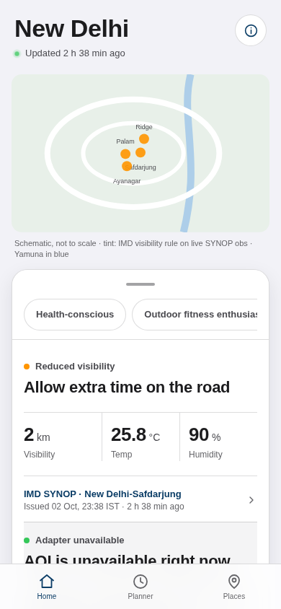
Mausam home: actions with proof
[Team Name]
Proposed Solution (Describe your Idea/Solution/Prototype)
Decision stack on a map + bottom sheet
Every value shows source, station and age
Honest gaps; labelled adapters; planner

Slide 3
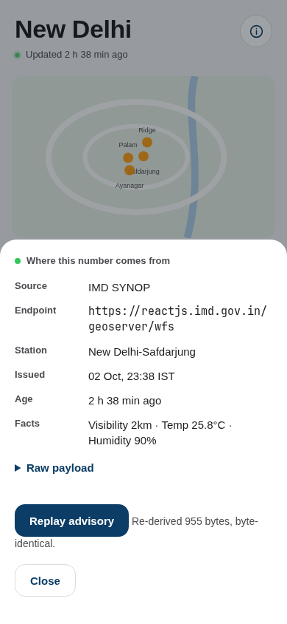
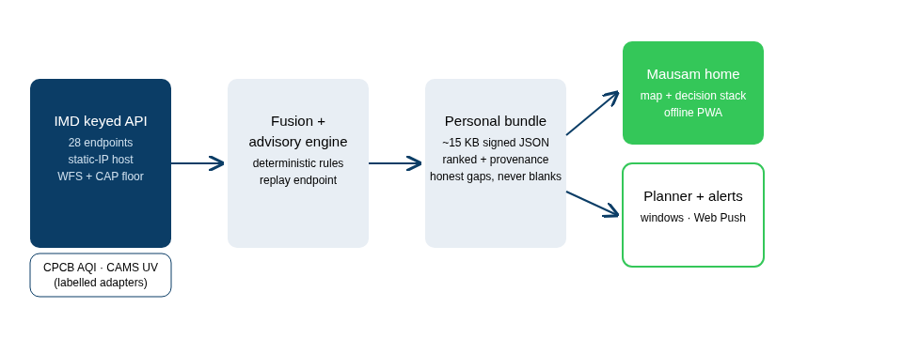
TECHNICAL APPROACH
[Team Name]
Vanilla PWA; offline-first, age always shown
Deterministic engine with byte-identical replay

Slide 4
FEASIBILITY AND VIABILITY
[Team Name]
Mock runs on real IMD captures; keyed API needs the host
CPCB reachability, undocumented fields, iOS push limits
Labelled fallbacks; stated grain; Android demo + inbox

Slide 5
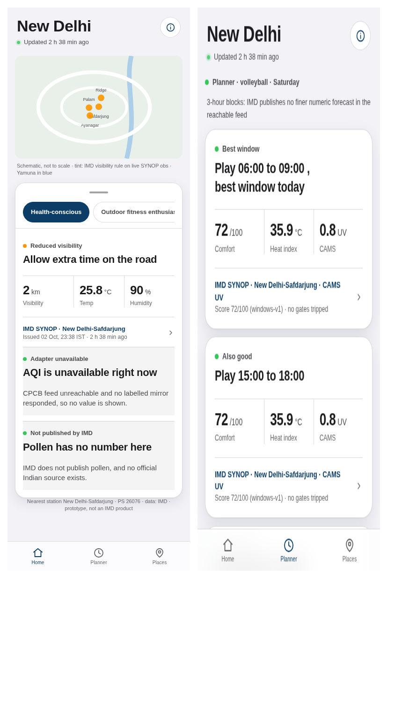
IMPACT AND BENEFITS
[Team Name]
Actions with evidence, not bare charts
Lineage, replay and gap cards are the moat

Slide 6
RESEARCH AND REFERENCES
[Team Name]
IMD API reference + portal user guide (key, hourly JWT, static IP): api.imd.gov.in
CPCB real-time AQI (GODL): data.gov.in; XKDR India Air Quality DB (CC BY 4.0)
Copernicus CAMS atmosphere data store: ads.atmosphere.copernicus.eu
MeitY UX4G design system; PIB Mausam note; Pai et al. 2014 rainfall climatology
Mock, fixtures, replay tests: Mausam/app, docs/evidence

